Slide 1
WATER POLLUTION AND ITS MANAGEMENT UNIT V 18CEO405T

Slide 2
RAINWATER HARVESTING
Defined as the collection, control and utilization of rainwater close to the point it reaches the earth.
Rainwater harvesting is defined as concentration, collection, storage, and use rainfall via runoff for various purposes such as domestic, livestock and agricultural use.
It is a system which consists of a catchment area (the surface on which runoff is generated), command area (the area where runoff is utilized), runoff transfer infrastructure (channels, gullies, hard surfaces) diversion method and storage structures.
Rainwater harvesting which applies water directly into the field ranges from in-situ techniques such as contour ridging, deep ploughing, terracing, which prevent runoff and promote infiltration where rain falls directly on the crop area
Rain Water Harvesting (RWH) is an age old practice throughout the world for obtaining natural soft water, potable as well as non-potable indoor usages and for sustaining livelihoods such as in agriculture.
RWH can also be used in aquifer replenishment, erosion control as well as flood control.
Rainwater is usually free from physical and chemical contaminants such as pesticides, lead, Arsenic, colour, suspended materials and it is low in salt and hardness.

Slide 3
COLLECTION OF RAINWATER
RWH system, it is the collection area which determines the amount of rainwater that can be harvested in any given rain event. Simply taken as the product of the projected surface which is exposed to rain (A) and the rainfall depth (R), the maximum amount of rainwater that can be harvested therefore is given by
Collection Area X Rainfall depth = AR
Depending on the surface texture and type of the roof, equation can be modified to indicate the actual roof collection as
Collection Area (A) X Rainfall depth (R) X Collection efficiency (C_{f}) = (AR)_{Actual}
Where C_{f} is a function of texture, absorption quality of the surface and function of the roof pitch.

Slide 4
COLLECTION OF RAINWATER
The three main components, namely the collector surface, rainwater transport system and the storage tank constitute a system that can be used to harvest rainwater as per the demand as well as supply, i.e. rainfall depth and collector area.
In addition, to improve the quality of collected rainwater, various devices can be introduced, particularly to flush out the initial amount of roof or surface collection that could mostly be contaminated after a prolonged dry period, to filter out debris and other contaminants before use and for extraction of water out of the tank or cistern.

Slide 5
ANCIENT INDIAN METHODS OF WATER HARVESTING
Water has been harvested in India since antiquity, with our ancestors perfecting the art of water management. Many water harvesting structures and water conveyance systems specific to the different cultures were developed.
In ancient times, houses in parts of western Rajasthan were built so that each had a roof top water harvesting system. Rainwater from these rooftop was directed into underground tanks, this system can be seen even today in all the forts, palaces and houses of the region.
Underground baked earthen pipes and tunnels to maintain the flow of water and to transport it to distant places, are still functional at Burhanpur in Madhya Pradesh, Golkunda and Bijapur in Karnataka, and Aurangabad in Maharastra.
They harvested the rain drop directly. From rooftop, they collected water and stored it in tanks built in their courtyards. From open community lands, they collected the rain and stored it in artificial wells.
They harvested monsoon runoff by capturing water from swollen streams and rivers during the monsoon season and stored it various forms of water bodies.

Slide 6
MODERN METHODS OF WATER HARVESTING
Rain water harvesting techniques: There are two main techniques of rain water harvesting:
1. Storage of rain water on surface for future use
2. Recharge to ground water
The storage of rain water on surface is a traditional technique and structures used were tanks, ponds, check dams, weirs etc. recharge to ground water is a new concept of rain water harvesting and the structures generally used are:
Pits: Recharge pits are constructed for recharging the shallow aquifer.
Aquifer: The aquifer is porous, water saturated layers of sand, gravel or bed rock that can yield significant or usable amount of water. These are constructed 1 to 2 m wide, 1 to 1.5 m deep which are back filled with boulders, gravels, coarse sand.

Slide 7
MODERN METHODS OF WATER HARVESTING
Trenches: These are constructed when the permeable rock is available at shallow depth. Trench may be 0.5 to 1 m wide, 1 to 1.5 m deep and 10 to 20 m long depending upon the availability of water. These are back filled with filter materials.
Dug wells: Existing dug wells may be utilized as recharge structure and water should pass through filter media before putting into dug well.
Hand pumps: The existing hand pumps may be used for recharging the shallow/deep aquifers, if the availability of water is limited. Water should pass through filter media to avoid chocking of recharge wells.

Slide 8
MODERN METHODS OF WATER HARVESTING
Recharge wells: Recharge wells of 100 to 300 mm diameter are generally constructed for recharging the deeper aquifers and water is passed through filter media to avoid choking of recharge wells.
Recharge Shafts: For recharging the shallow aquifer which is located below clayey surface, recharge shafts of 0.5 to 3 m diameter and 10 to 25 m deep are constructed and back filled with boulders, gravels and coarse sand.
Lateral shafts with bore wells: For recharging the upper as well as deeper aquifers lateral shafts of 1.5 to 2 m wide and 10 to 30 m long depending upon availability of water with one or two bore wells is constructed. The lateral shaft is back filled with boulders, gravels and coarse sand.

Slide 9
CLASSIFICATION OF RAIN WATER HARVESTING
Rooftop rain water harvesting system:
It is a system of catching rainwater where it falls. In rooftop harvesting, the roof becomes the catchments, and the rainwater is collected from the roof of the house/building. It can either be stored in a tank or diverted to artificial recharge system. This method is less expensive and very effective and if implemented properly helps in augmenting the groundwater level of the area.
Sub Components of Rooftop rain water harvesting system:
Catchments :
Transportation
First flush
Filter

Slide 10
CLASSIFICATION OF RAIN WATER HARVESTING – SUB COMPONENTS OF ROOF TOP RAINWATER HARVESTING
Catchments:
The surface that receives rainfall directly is the catchment of rainwater harvesting system. It may be terrace, courtyard, or paved or unpaved open ground.
The terrace may be flat RCC/stone roof or sloping roof. Therefore the catchment is the area, which actually contributes rainwater to the harvesting system.
Transportation:
Rainwater from rooftop should be carried through down take water pipes or drains to storage/harvesting system. Water pipes should be UV resistant (ISI HDPE/PVC pipes) of required capacity.
Water from sloping roofs could be caught through gutters and down take pipe. At terraces, mouth of the each drain should have wire mesh to restrict floating material.
First flush:
First flush is a device used to flush off the water received in first shower. The first shower of rains needs to be flushed-off to avoid contaminating storable/rechargeable water by the probable contaminants of the atmosphere and the catchment roof.
It will also help in cleaning of silt and other material deposited on roof during dry seasons Provisions of first rain separator should be made at outlet of each drainpipe.

Slide 11
CLASSIFICATION OF RAIN WATER HARVESTING
Filter:
Filters are used for treatment of water to effectively remove turbidity, colour and microorganisms. After first flushing of rainfall, water should pass through filters. A gravel, sand and ‘netlon’ mesh filter is designed and placed on top of the storage tank.
This filter is very important in keeping the rainwater in the storage tank clean. It removes silt, dust, leaves and other organic matter from entering the storage tank. The filter media should be cleaned daily after every rainfall event.
Clogged filters prevent rainwater from easily entering the storage tank and the filter may overflow. The sand or gravel media should be taken out and washed before it is replaced in the filter.

Slide 12
CLASSIFICATION OF RAIN WATER HARVESTING
Micro Level Rain water harvesting:
At the micro level, they collected rainwater directly from rooftops and stored it in below ground level (bgl) tanks.
In every premises, whether it be a house, multi-storeyed residential and/or commercial complex, office, factory etc., rainwater falls only on two places: 1) rooftop 2) all around the builtup area, which could be a driveway, garden etc.
I) Direct at least one or more of these pipes located close to the existing below ground level masonry tank (also called sump, which in Chennai is meant for receiving water supplied by the municipality) into it through a filter.
II) Any overflow from the sump can be led into an open/dug well, if any, within the premises. Pipes not directed to the sump can also be led into the well
III) In the absence of an open well, a percolation/recharge well could be dug and the same can be made use of to put the rooftop water into it.
IV) In houses/flat complexes where there is not enough space around the built-up area to dig a recharge well, a percolation/recharge pit could be made for the purpose of putting rooftop water into it.

Slide 13
MICRO AND MACRO LEVEL RAIN WATER HARVESTING
The main distinction micro and macro is the runoff transfer distance and ratio of the catchment to cropped areas.
In macro-catchment RWH systems, runoff volumes and flow rates are high as compared to in-situ or micro catchment RWH systems.
This gives rise to problems in managing potentially damaging peak flows, which may lead to serious erosion and/or sediment deposition. Substantial channels and runoff control structures may be required.
Macro catchment RWH system is a complex function of the characteristics of rainfall amount received at the catchment areas, land surface between runoff producing to runoff utilization, transfer distance and the soil type.
Macro catchment RWH connects not only pieces of land but also social economic groups like farmers and agropastroalist.

Slide 14
BENEFITS OF ROOFTOP RAINWATER HARVESTING
1. Provides self-sufficiency to your water supply
2. Reduces the cost for pumping of ground water
3. Provides high quality water, soft and low in minerals
4. Improves the quality of ground water through dilution when recharged to ground water
5. Reduces soil erosion in urban areas
6. The rooftop rain water harvesting is less expensive
7. Rainwater harvesting systems are simple which can be adopted by individuals
8. Rooftop rain water harvesting systems are easy to construct, operate and maintain
9. In hilly terrains, rain water harvesting is preferred
10. In saline or coastal areas, rain water provides good quality water and when recharged to ground water, it reduces salinity and also helps in maintaining balance between the fresh-saline water interface
11. In Islands, due to limited extent of fresh water aquifers, rain water harvesting is the most preferred source of water for domestic use
12. In desert, where rain fall is low, rain water harvesting has been providing relief to people

Slide 15
TWAD BOARD
TWAD Board is vested with the responsibility of providing Water Supply & Sewerage facilities in the entire State of Tamil Nadu, except Chennai Metropolitan area and have implemented various programmes sponsored by the Government of India and Government of Tamil Nadu during the past four decades.
In addition to the above, many Industries/Institutions are approaching TWAD Board for their water requirement. Though the prime focus of TWAD Board is to cater to the community needs, Industrial needs also have to be taken care off, to pave way for a sustainable development. There is a provision in the TWAD Board Act, to cater to the water supply and sanitation requirement of Industries and Institutions. Such works towards Industries and institutions are taken up by TWAD Board as Deposit works.
TWAD ACT:
As per TWAD Board Act Rules 1973, The Board may on the direction of Government, take up the investigation, preparation, execution and maintenance of any scheme for the provision of water and drainage facilities, to meet the needs of any industries or institutions within the area of the local authority.
Accordingly, proposals seeking clearance to take up investigation, implementation and maintenance of Water Supply Scheme to certain industries/institutions, as Deposit Works, were placed before the Board then and there for recommending to Government and clearance had been sought for, with the recommendation of Board.

Slide 16
CMWSSB
Chennai Metropolitan Water Supply and Sewerage Board:
Till about the middle of 19th Century Chennai received water from local shallow wells and tanks. Mr. Fraser, a Civil Engineer forwarded a proposal to the Government to tap the Koratalayar river which is situated about 160 km north west of Chennai and it was accepted. The works were completed in 1870 at a cost of 18.50 lakhs. In 1872 a Valve house at Red Hills and an earthen supply channel to supply water to Chennai by gravitation was constructed. At Chennai end, the channel delivered water by gravity to a masonry shaft at Kilpauk from which the cast iron mains of the city branched off and a scientifically designed water supply distribution system was established.
Accordingly to J.W. Madley, Special Engineer, Corporation of Chennai considered sufficient for an anticipated population of 6.6 lakhs in 1961 at 25 gallons per head per day.
The work of water supply distribution and sewerage work were looked after by Water Works Department and Special Works Department of Corporation of Chennai respectively.
Subsequently in 1978, CMWSS Board was formed by an Act called Chennai Metropolitan Water Supply and Sewerage Act 1978, CMWSSB stands committed to making a positive contribution to improve the Chennai City environment and to enhance the health and quality of life for the citizens in Chennai City by providing them with adequate supply of safe and good quality water, by collection, treatment and safe disposal of sewage at a reasonable price, and by providing customer service in prompt and courteous manner.

Slide 17
WATER CRISIS
When an individual does not have access to safe and affordable water to satisfy her or his needs for drinking, washing or their livelihoods we call that person water insecure”. Hence, when a large number of people in an area are water insecure for a considerable period of time, in that case, we can name that area water scarce.
Reasons for water scarcity:
Water scarcity is one of the greatest challenges of the twenty-first century. Overpopulation, Agriculture, Pollution of water and improper government policies are the important reasons for water scarcity.
Forest Agriculture Organization reported agriculture, encompassing crops, livestock, fisheries, aquaculture, and forestry, is both a cause and a victim of water scarcity. It accounts for an estimated 70 percent of global water withdrawals, while competition with other sectors for water is increasing.

Slide 18
WATER CRISIS
Climate change also affects freshwater resources negatively, in terms of both quantity and quality. Particularly the demand for water in India is steeply increasing because of several reasons, such as urbanisation, Industrialisation, more water for agriculture production and vigorous population growth.
Population growth:
The world’s population is growing at a rate of 80 million people each year. This means that each year we need to find a way to add about 64 billion cubic meters of water to the global water supply India is the second-most populous country in the world, with more than 1 billion citizens. Roughly half of India’s population, a staggering 569 million, practice open defecation.
In the year 2030, India will be number one in population. There are millions of people all over the world who don’t have access to water, or, if they have access, that water is unable to be used.
About 70% of the Earth’s surface is covered with water and 3% of it is actually freshwater that is fit for human consumption. According to WWF (world wildlife fund), some 1.1 billion people worldwide lack access to water, and a total of 2.7 billion find water scarce for at least one month of the year.

Slide 19
WATER CRISIS
Pollution of water:
Water pollution affects the entire biosphere plants and organisms living in these bodies of water. Water pollution is a major global problem which requires ongoing evaluation and revision of water resource policy at all levels.
In view of population increase, the demand for freshwater for all the uses will be unmanageable. According to the status of water quality in India (2011), it is estimated that the projected wastewater from urban centres may cross 1,00,000 mld (millions of litter per day) by 2050 and rural India will also generate not less than 50,000 mld in view of water supply designs for community supplies in rural areas.

Slide 20
WATER CRISIS
Agriculture use:
Ninety percent of total water resources used in agriculture. Eighty percent of groundwater goes to irrigation and agricultural purposes.
While agriculture is one of our countries most significant water users some innovative solutions have been developed to improve water use efficiency and maintain or even increase yields.
Government policies:
Government policies are playing a major role in reducing the water scarcity problems and the government should initiate the water-related activities such as project, awareness programmes to know the importance of water conservation so the country able is to avoid over-exploitation of water.

Slide 21
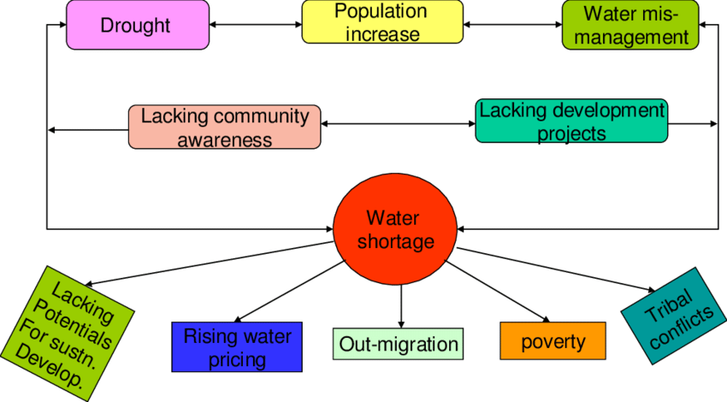
WATER CRISIS AND THEIR EFFECTS

Slide 22
WATER CRISIS AND THEIR EFFECTS
Lack of drinking water:
The availability of total freshwater resources in the world are estimated to be in the order of 43,750 km3 year−1, distributed throughout the world; at the continental level, America has the largest share of the world’s total freshwater resources, with 45%, followed by Asia with 28%, Europe with 16%, and Africa with 9%. In terms of resources per inhabitant in each continent, America has 24,000 m3 year−1, Europe 9300 m3 year−1, Africa 5000 m3 year−1 and Asia 3400 m3 year−1.
Clean drinking water is scarce and there are millions of people and other organisms across this globe who spend their entire day searching for it.
Water scarcity involves water crisis, water shortage, water deficit or water stress. The biggest problem that happens when you have water scarcity is that people are not able to get fresh, clean drinking water.

Slide 23
WATER CRISIS AND THEIR EFFECTS
Hunger:
Non-availability of water leads to low production which ends in hunger and poverty. Animals will also die, which will result in a lack of meat as well. Water scarcity, in short, causes starvation to occur as a group for both people and animals that are located in the area.
Lack of education:
Water scarcity makes it difficult for people to get the education that they need or that they deserve. Why? Mainly, because those children are either too sick to go to school or they are working to help get water to the home and the family.
Cairncross et al. (1987) highlighted that villagers in a study community without a close water supply stated that they often “cooked little, and only once a day, because of the lack of water”. In the same study, the findings provide a detail that the community with better water access had a prevalence of trachoma of 19% versus 38% in the community without ready access to water.

Slide 24
WATER CRISIS AND THEIR EFFECTS
Lack of education:
The authors concluded that hygiene practices and hygiene-related health outcomes appeared directly related to how far the water source is from a household. Time spent collecting water has also been found to be associated with significant “coping costs and the people have a no time to study and they are able to concentration which automatically leads to lack of education and poverty.
Sanitation and other issues:
The direct health consequences of poor hygiene and sanitation are generally well known. It is estimated that nearly 5000 children die every day from the effects of diarrhoeal illnesses, 90 per cent of which are attributable to poor hygiene, sanitation and unsafe water (UNICEF 2006).
In countries with high infant mortality rates, the lack of access to clean water and sanitation kills more children than pneumonia, malaria, and HIV and AIDS combined. Hygiene and sanitation also help to control many non-fatal diseases which afflict young children, such as intestinal parasites, blinding trachoma, and impetigo.

Slide 25
WATER CRISIS AND THEIR EFFECTS
Poverty:
All in all, people who are dealing with water scarcity are often stuck in poverty as well. Most of the countries are now a day suffered this issue.
Water is the biggest resource to enhance the growth and economy of every nation. Water scarcity sees it as a symptom of poverty. Not having adequate water or sanitation is thus, seen as a characteristic of less developed countries.
The World Bank, report negative relationships between per capita GDP and percentage of the population not having access to water supply and sewerage.

Slide 26
REDUCING WATER SCARCITY
Increasing the water storage capacity has been one of the ways to mitigate water scarcity. Rain water harvesting is one of the key features to overcome this problem. Multiplied the farm ponds, percolation tanks, water reservoirs and construction of small and medium size dams and rivers can ensure the ground water as well as surface water.
The prime important elucidation is to entwine of rivers will help in forestall floods while enhancing water distribution in the country and reforestation of degraded forests and development of wastelands through afforestation will help in soil and water conservation

Slide 27
REDUCING WATER SCARCITY
National Water Policy:
India had revised the NWP in 2002 with the following salient features (Government of India, 2009. Establishment of National and State level data banks to monitor the demand and supply These are some key points for facilitation for the transformation of available water resources into utilizable water and non-conventional methods for efficient water use.
Supply of water from water surplus areas to water shortage areas. Judicious allocation of water for different uses and pricing of water is to ensure sustainable development. Regulation on groundwater exploitation and close monitoring of water table using modern scientific techniques Sustainability of existing water bodies, involving all the stakeholders and local communities. The master plan for flood control is which mean linking different rivers and promoting soil conservation measures.

Slide 28
REDUCING WATER SCARCITY
Agriculture sector:
More food less water is a very important focus approach of current situation in agriculture. In the agricultural sector, one of the important components is an improvement in water usage efficiency and adoption of rainwater harvesting and watershed management techniques.
Another aspect in the agricultural sector reduction of subsidies on power supply particularly for pumping water which leads to prevention of groundwater exploitation by introducing differential pricing, rewards, and punishments. Implementation of National River Link project which aims to connect 30 rivers and canals to generates 175 trillion litres of water.

Slide 29
REDUCING WATER SCARCITY
Industrial sector:
The industrial sector is one Encourage recycling and treatment of industrial wastewater through regulations and subsidies. Encourage the introduction of new technologies which consume less water.
Domestic sector:
In the domestic sector, Introduction of a policy for mandatory rainwater harvesting in cities and Propagation of efficient water usage and creation of awareness about water conservation among the common public which is strengthening the water policy.

Slide 30
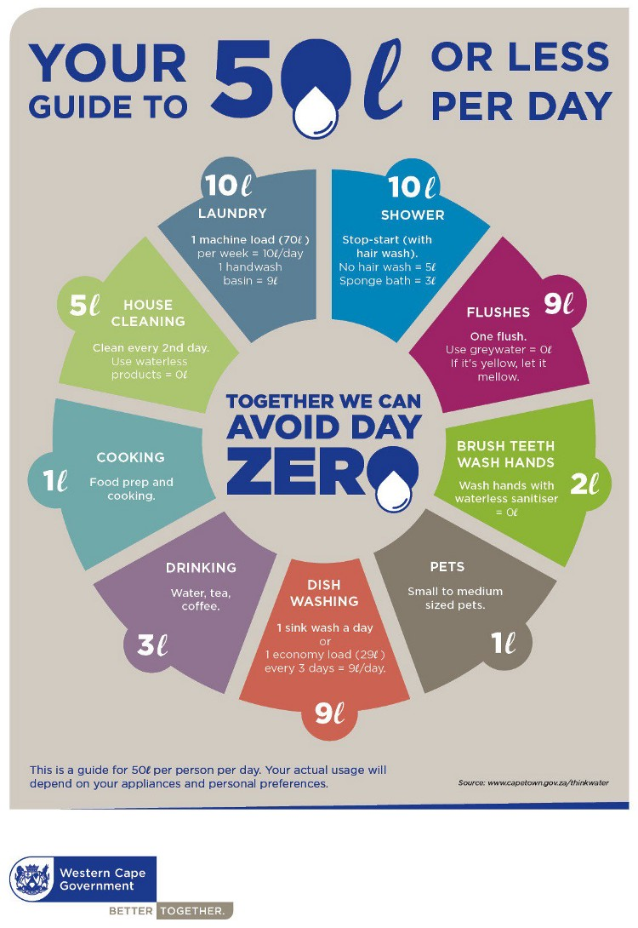
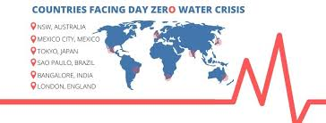
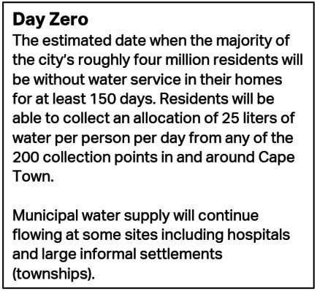
ZERO WATER DAY
Zero water Day - Awareness:
Zero water Day:
The day when a city’s taps dry out and people have to stand in line to collect a daily quota of water.
Zero water Day - Awareness:

Slide 31
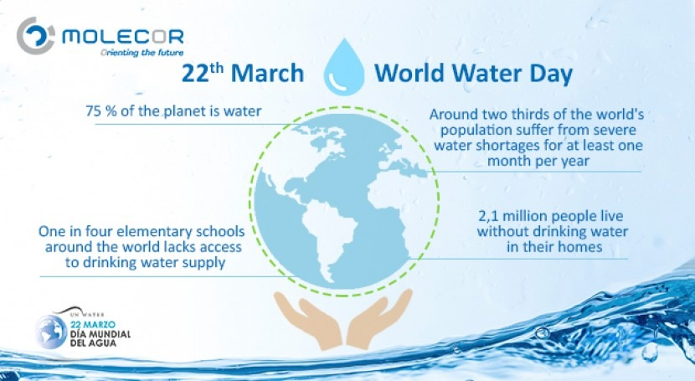
WORLD WATER DAY
World Water Day is held annually on 22 March as a means of focusing attention on the importance of freshwater and advocating for the sustainable management of freshwater resources.
It is about taking action to tackle the global water crisis, in support of Sustainable Development Goal (SDG) 6: water and sanitation for all by 2030.

Slide 32

WORLD ENVIRONMENT DAY
The United Nations designated 5 June as World Environment Day to highlight that the protection and health of the environment is a major issue, which affects the well-being of peoples and economic development throughout the world.
The celebration of this day provides us with an opportunity to broaden the basis for an enlightened opinion and responsible conduct by individuals, enterprises and communities in preserving and enhancing the environment.

Slide 33
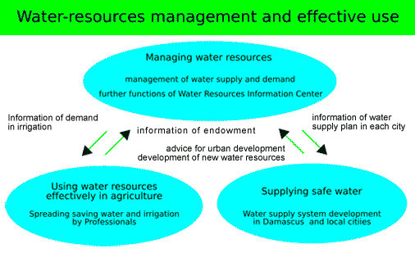
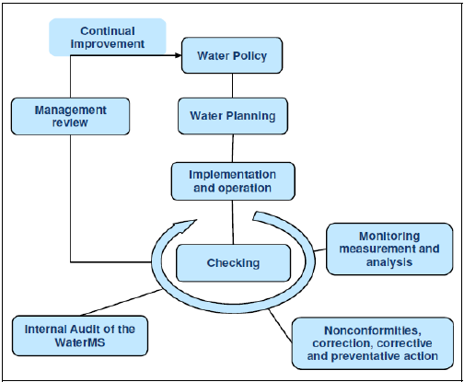
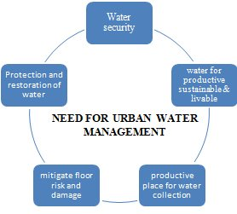
WATER MANAGEMENT

Slide 34
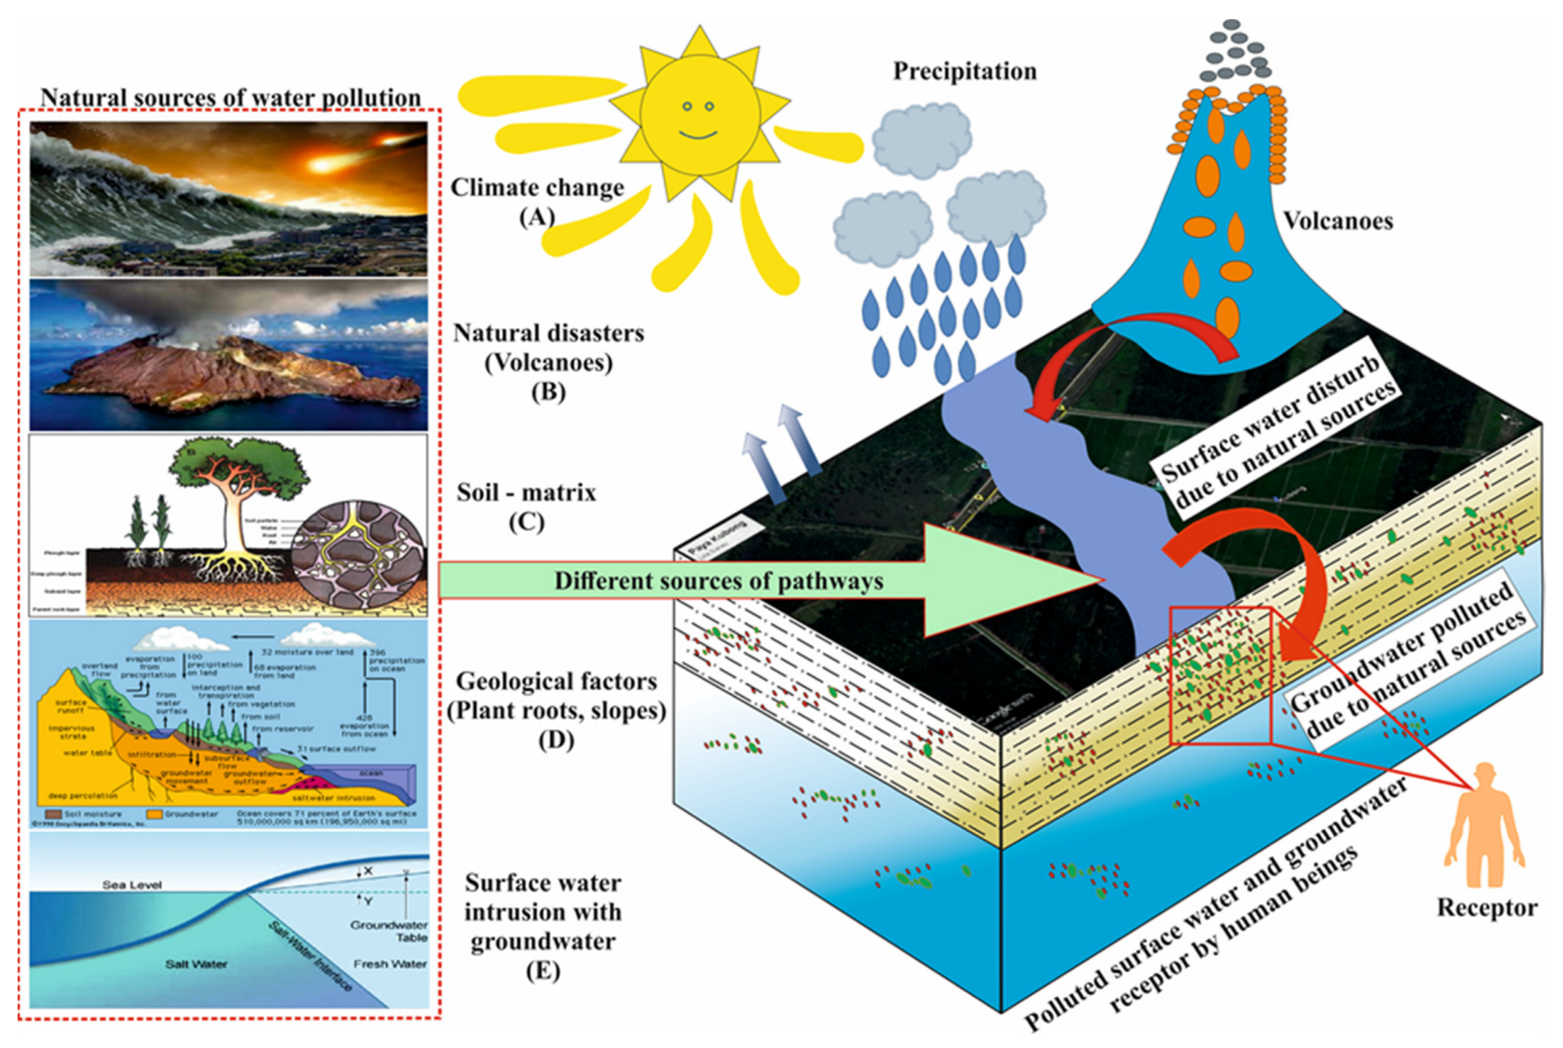
IMPROPER WATER MANAGEMENT

Slide 35
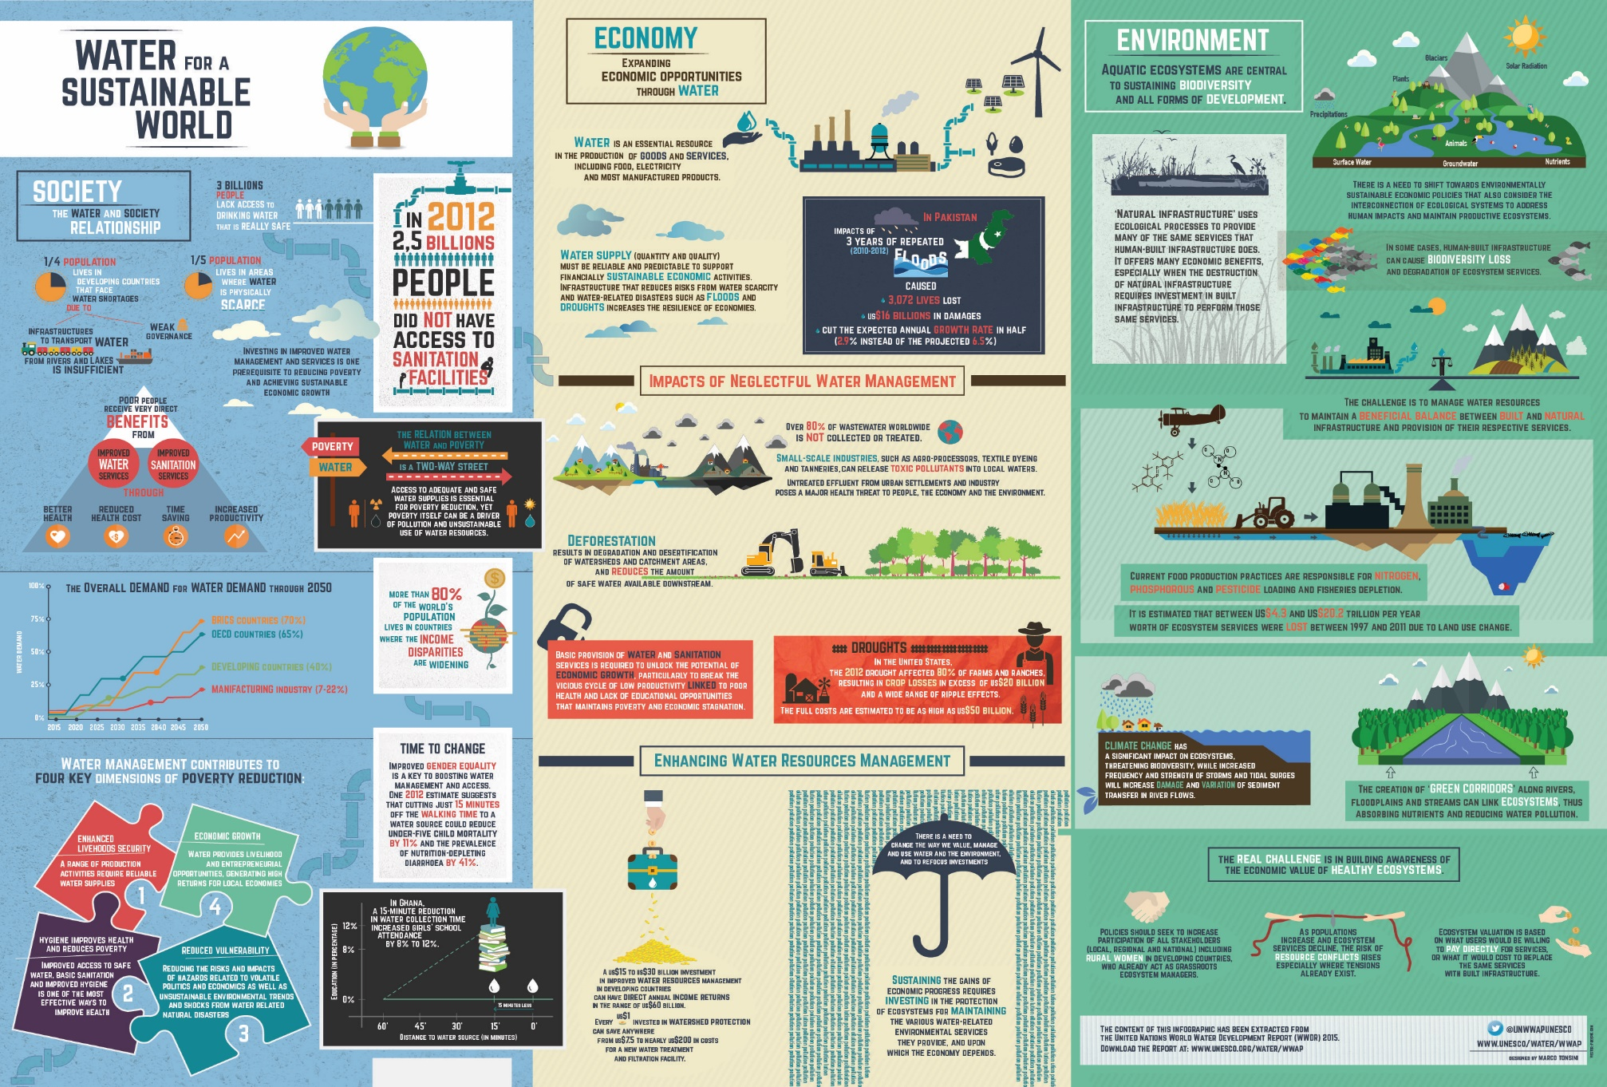
WATER MANAGEMENT AND SUSTAINABLE DEVELOPMENT

Slide 36
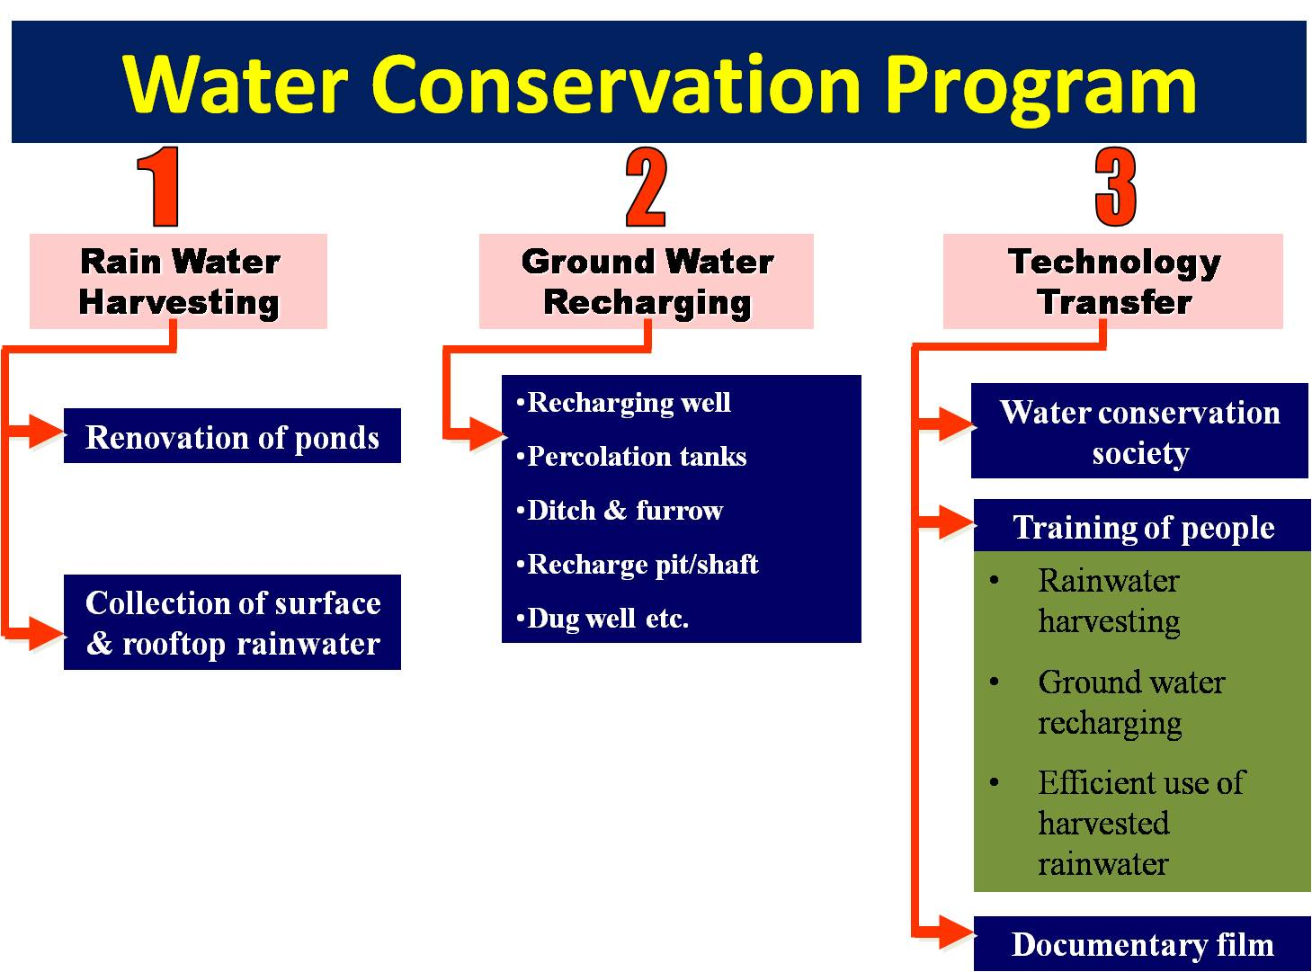
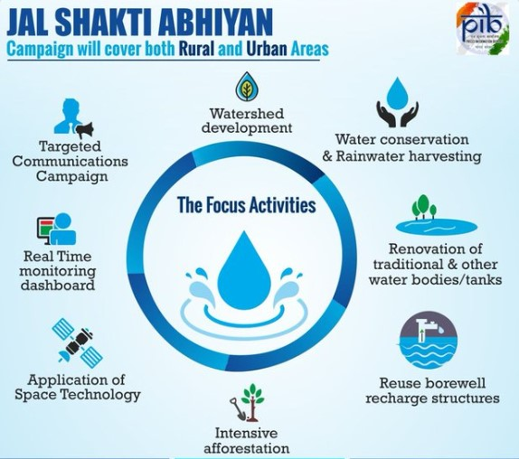
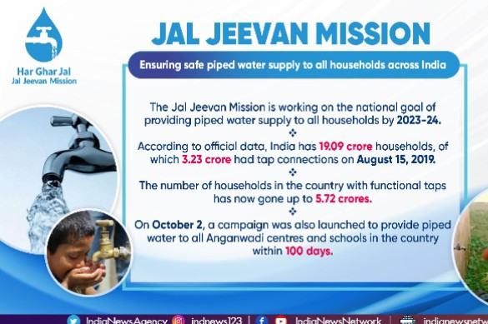
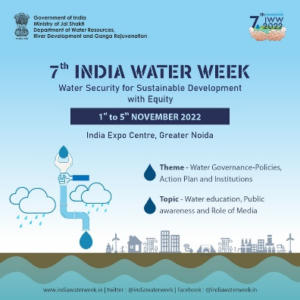
AWARENESS PROGRAMME FOR WATER MANAGEMENT AND ITS SUSTAINABLE DEVELOPMENT

Slide 37
WATER MANAGEMENT CHALLENGES IN INDIA
India is faced with dual problems in water resources.
First is of scarcity of freshwater due to the declining natural supplies and the increasing demand for enhancing food grain production, providing water supplies for drinking and industries, and ecosystem management.
The second is of increasing conflicts over sharing of water. The core water management needs are maintaining the balance between demand and supplies to address growing scarcity; and equitable allocation of water across sectors to resolve the conflicts.

Slide 38
WATER MANAGEMENT CHALLENGES IN INDIA
Data related issues:
Availability of scientific database:
One of the biggest challenges facing the water management sector in the country is the nonavailability of adequate scientific data needed for water budgeting, allocation planning, and water management decision-making.
Reliable estimates of water supply and demand are one of the core needs for water management.
Estimates of water availability and landuse:
The two key components of water supplies are surface water and groundwater. So far as groundwater is concerned, the supplies are determined on the basis of the average annual recharge.
The methodology adopted for recharge estimation has weak scientific basis and hence the estimates are questionable. The “water level fluctuation approach” used for recharge estimation has many inherent limitations.
In the first place, it assumes that all the monsoon recharge appears as a rise in water level in the wells and conveniently neglects the portion of the recharge pumped out during the monsoon season, the inflows into the aquifer basin and the outflow from the basin.

Slide 39
WATER MANAGEMENT CHALLENGES IN INDIA
Estimates of water availability and landuse:
Secondly, it also does not capture the long-term trends in groundwater levels in a particular area as only the previous five-year data are considered for estimation. Therefore, it fails to provide a realistic assessment of the overall groundwater situation in an area.
Water Quality:
Quality is another important variable that determines the suitability of water for a particular purpose and hence quantity and quality issues are inter-linked. There are numerous biological, physical and chemical parameters that determine the quality of water.
There are four important issues associated with water quality monitoring. i) There are a few observation stations in the country that cover all the essential parameters for water quality and hence the data obtained are not decisive on the water quality status.

Slide 40
WATER MANAGEMENT CHALLENGES IN INDIA
Water Quality:
ii) Water quality measurements involve expensive, sophisticated and that are difficult to operate and maintain; and require substantial expertise in collecting, analysing and managing the data. Therefore, in a country like India, where water technology is still not advanced, it is very likely that the available data on water quality is less reliable.
iii) The existing methodology for water quality management is inadequate to identify the various sources of pollution and contamination of water
iv) Available water quality data are hardly integrated with data on water availability of water supplies. But, such integration is very important not only from a purely physical science perspective, but also from the point of view of assessing water availability for meeting various social, economic and environmental objectives.

Slide 41
WATER MANAGEMENT CHALLENGES IN INDIA
Water Quality:
Demand estimation in different sectors of water use is often based on agency norms. These norms fail to capture the variations in physical, socio-economic, cultural and institutional factors that greatly influence the demand of water in various sectors.
As a result, the demand figures estimated through norms are unrealistic.

